Slide 1
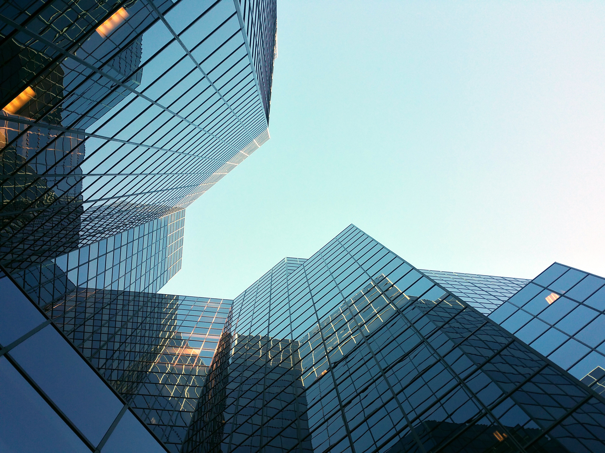

GOLDENSEA PROFILE
All for customer satisfaction and more....
www.goldensea.net.vn

Slide 2
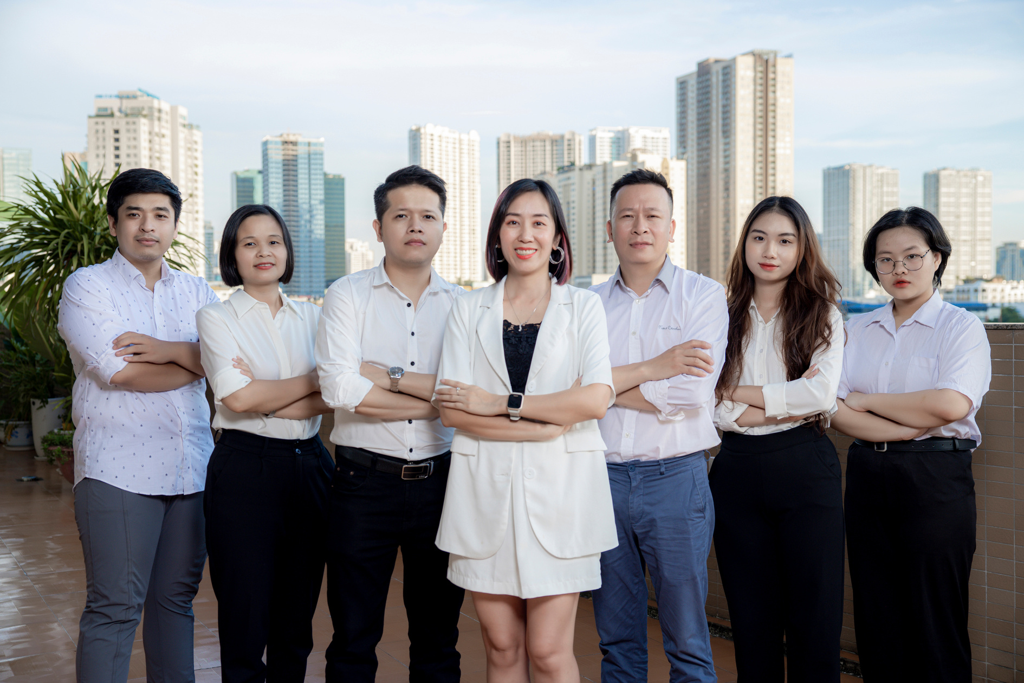
GOLDENSEA COMPANY PROFILE
INTRODUCTION
Goldensea Interior boasts over 14 years of experience in office design and has completed more than 1500 projects nationwide. We will provide our clients with an optimal space, a unique style in each design, and above all, customer satisfaction with meticulously crafted interior products.
We strive every day for customer satisfaction. Just one experience and you'll feel all the value.
14+
1500+
YEARS OF EXERIENCE
PROJECTS
We have many years of experience in interior design and construction.
The project and its clients are reputable companies.

Slide 3
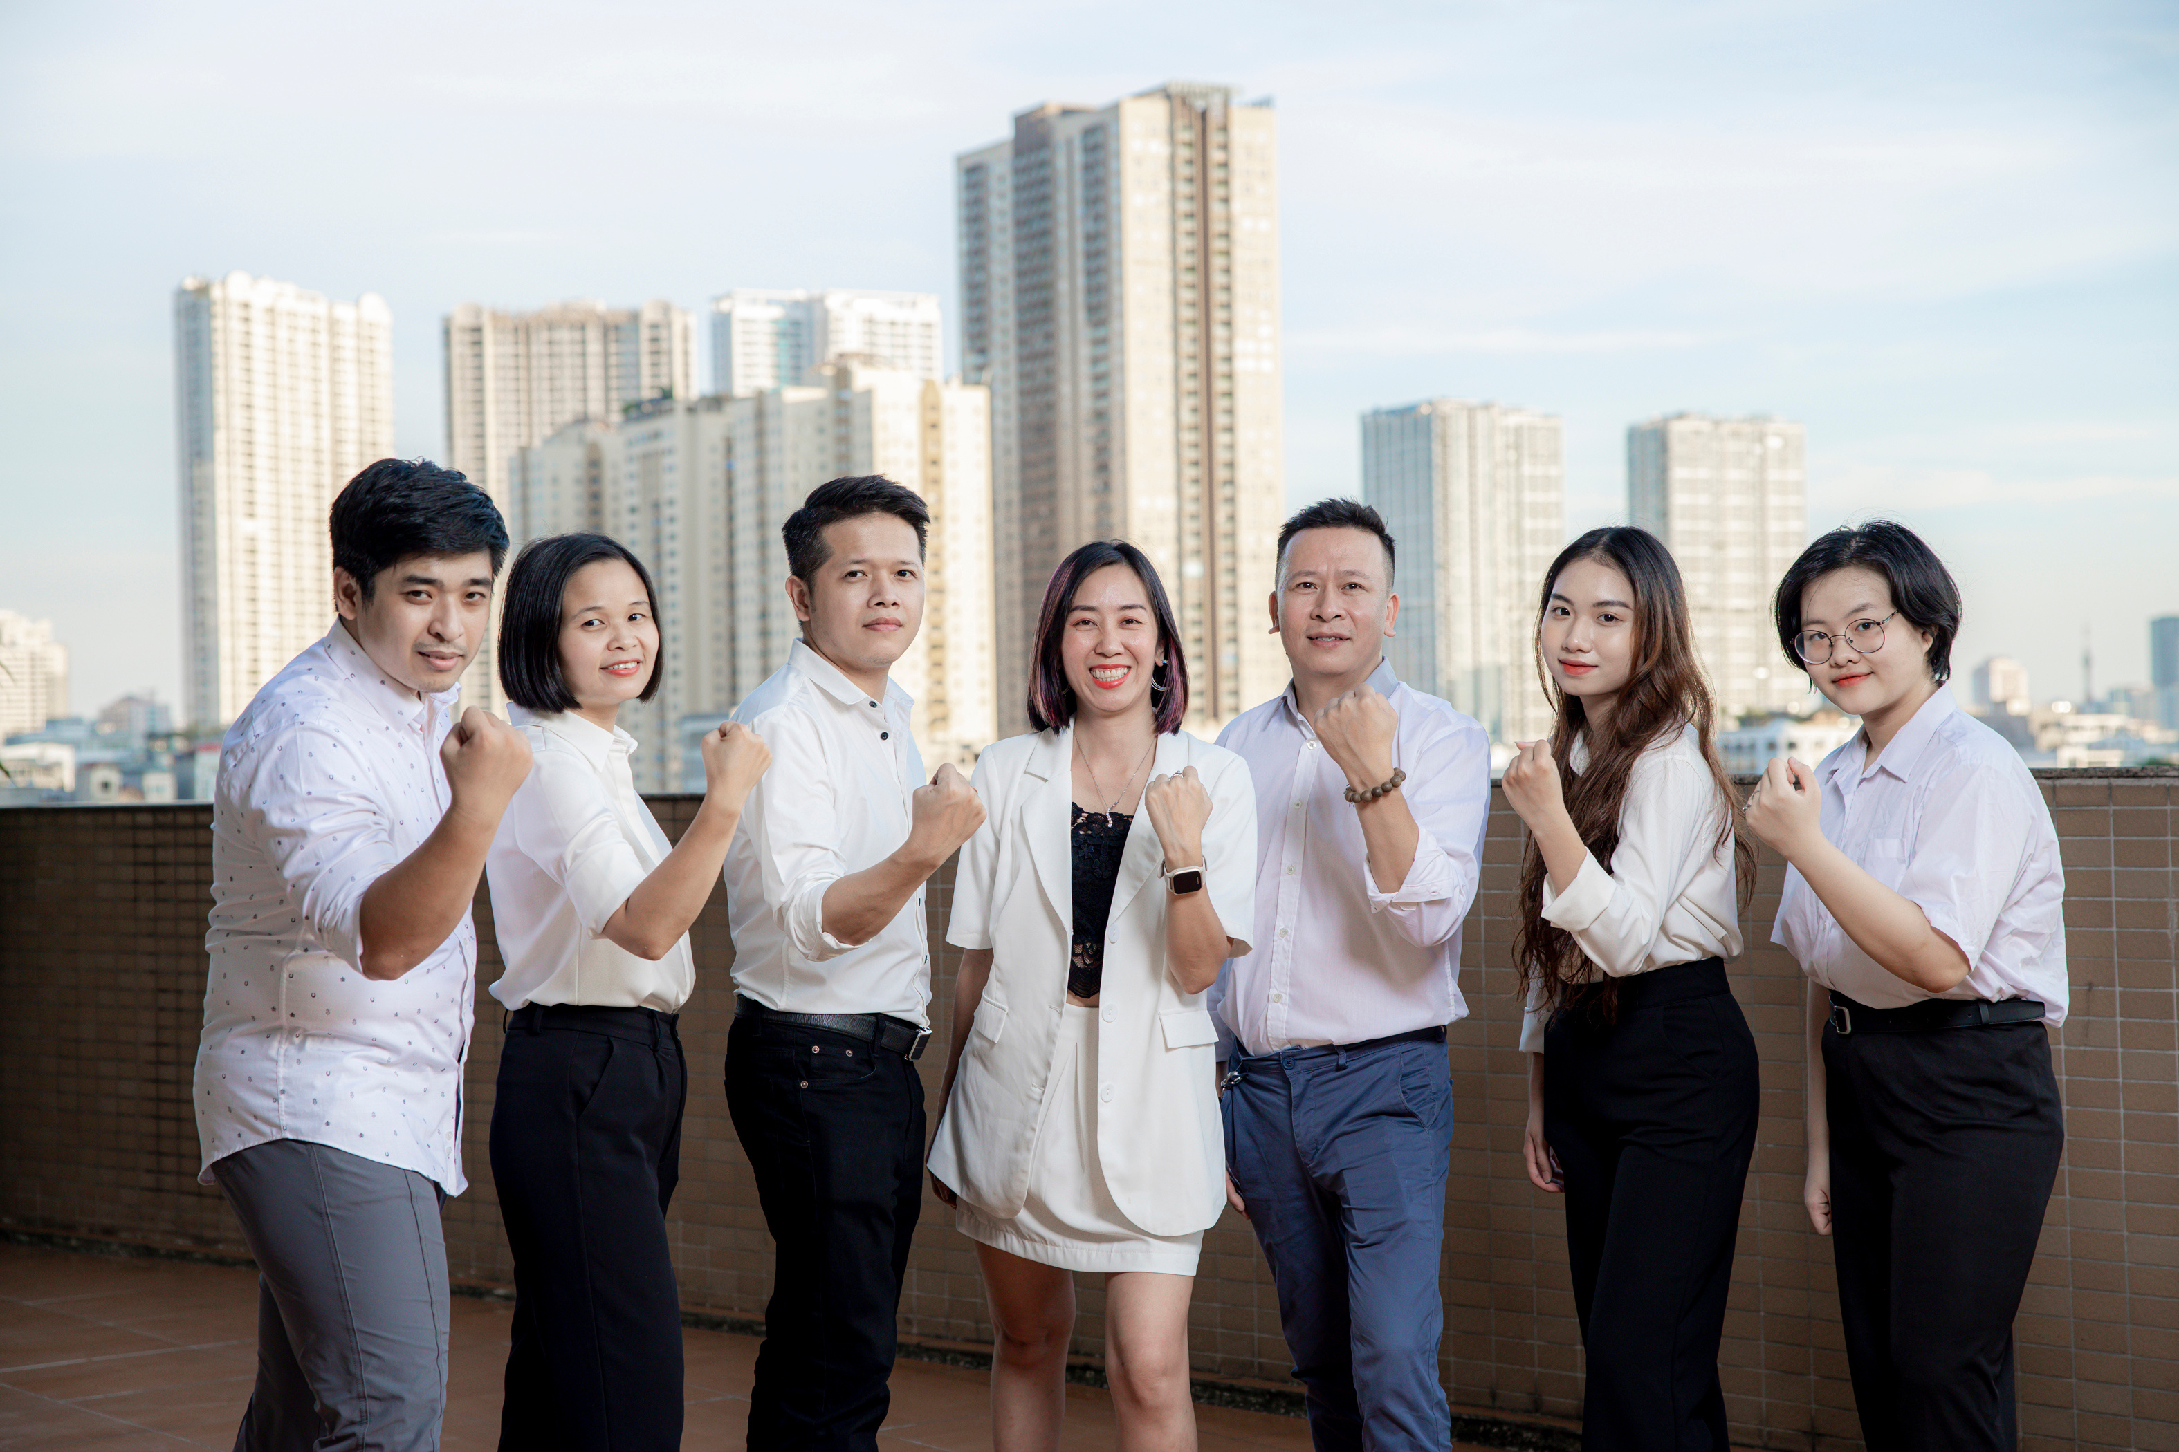
OUR MISSION
OUR VISION
GoldenSea offers living and working spaces designed for optimal functionality, aesthetics, and sustainability, meeting user needs and clearly reflecting the brand identity, individual personality, and development direction of our clients.
GoldenSea aims to become a leading office interior design and construction company, creating modern, optimized, and inspiring workspaces. We aspire to elevate design standards in Vietnam through innovative, sustainable solutions and the application of technology, contributing to building an efficient working environment for all businesses.

Slide 4


Slide 5





WHY CHOOSE GOLDENSEA INTERIOR?
These are the reasons why customers trust Goldensea, based on thousands of completed projects over the years
A TOP-CLASS DESIGN TEAM
100% PROGRESS
guarantEED
UNDERSTANDING
THE CUSTOMER
COST SAVINGS
DIVERSE EXPERIENCES
We are a creative team with designs that have received high praise from domestic and international companies.
You don't want to wait, and neither do we. For many years, we've consistently completed projects on time or ahead of schedule.
With our expertise and extensive implementation experience, we are always supportive and flexible in our approach to our clients.
We are experts in optimal office design. Our professionalism and experience will help you save time and money.
With experience constructing hundreds of buildings, we are confident that we automatically understand the technical issues of each builder.

Slide 6
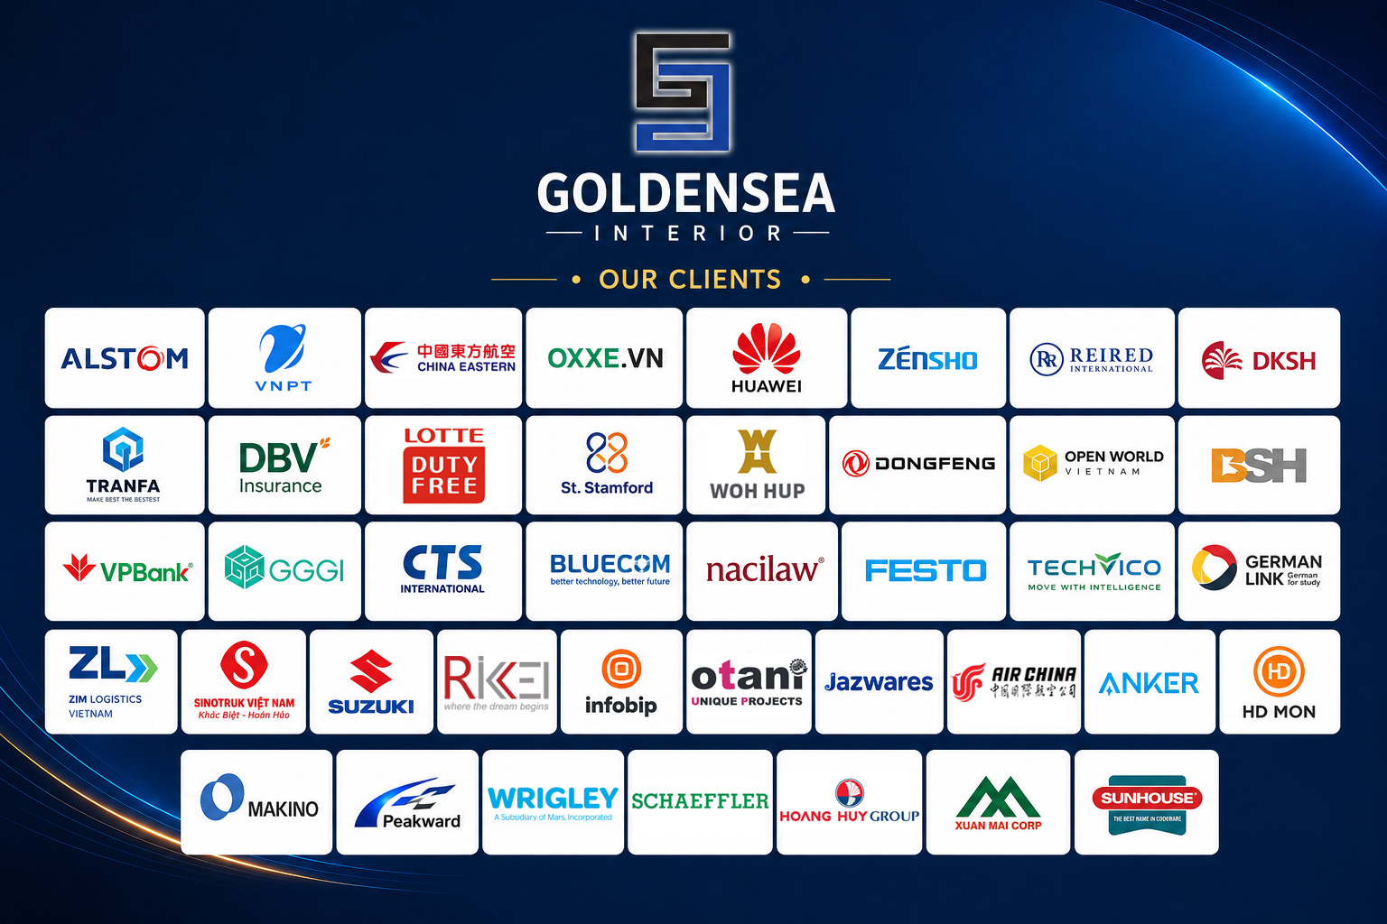

Slide 7
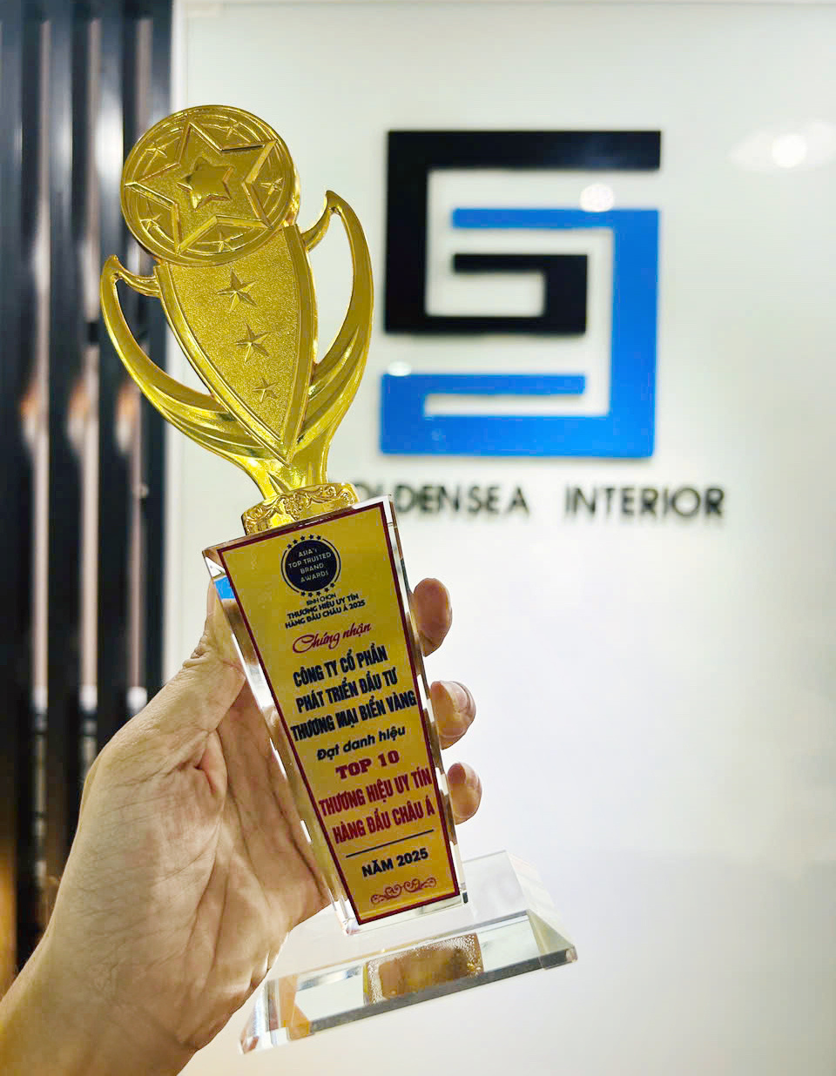
GOLDENSEA COMPANY PROFILE
AWARD AND ACHIVEMENT
Throughout its formation and development, Goldensea Interior has been honored to receive numerous professional certifications, prestigious awards, and awards in the field of interior design and construction. In particular, Goldensea Interior is proud to have been recognized as one of the TOP 10 Reputable Interior Design Companies in Asia-Pacific on September 27, 2025, at the Army Theater in Ho Chi Minh City, selected and awarded by the Asian Economic Research Institute, affirming the brand's position and influence in the regional market.
These achievements are not only a recognition of the tireless efforts of the entire team, but also clear evidence of the professional construction capabilities, creative thinking, and lasting reputation that Goldensea Interior has built and continues to build.

Slide 8
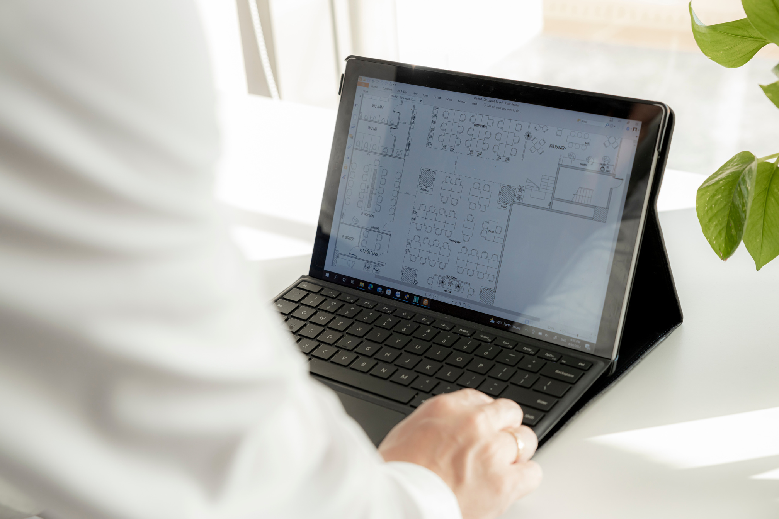
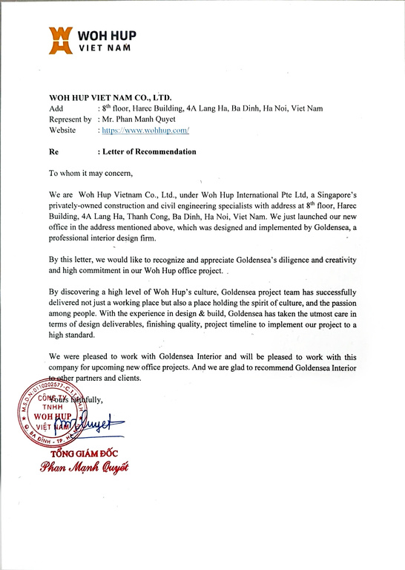
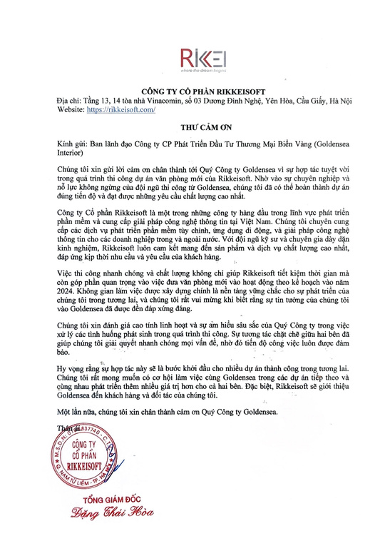
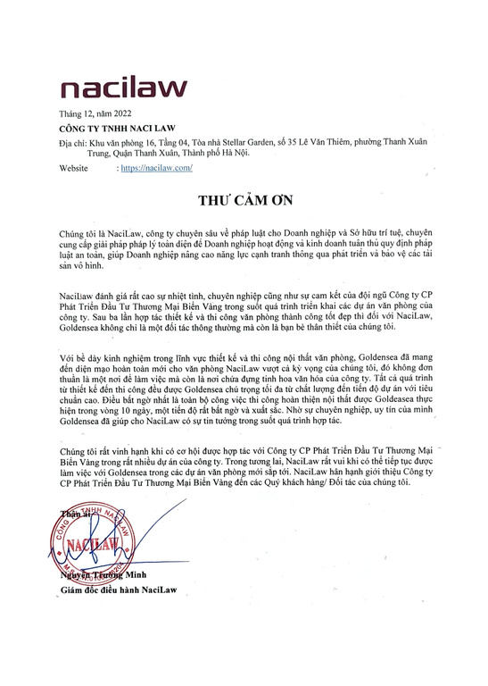
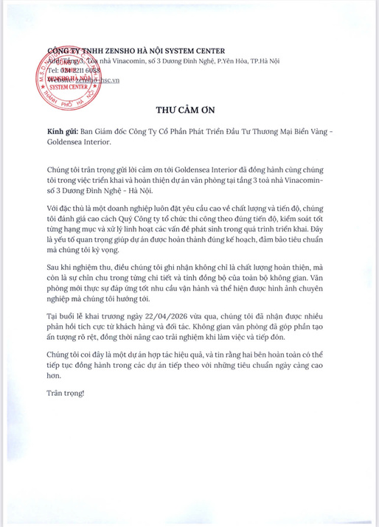
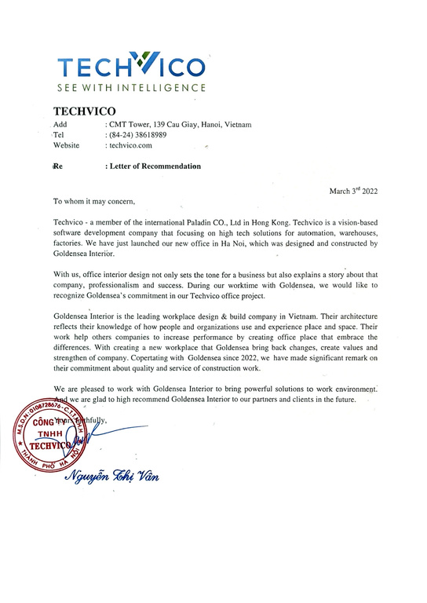
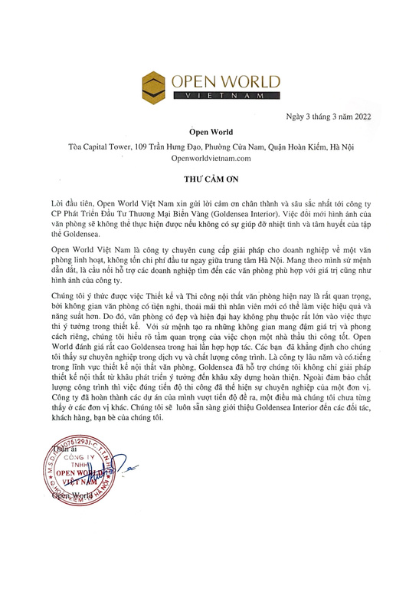
GOLDENSEA COMPANY PROFILE
TESTIMONIAL LETTER
We sincerely thank our clients for their continued trust and support of Goldensea Interior. These letters of appreciation serve as our greatest source of motivation to strive for excellence and grow every day.

Slide 9

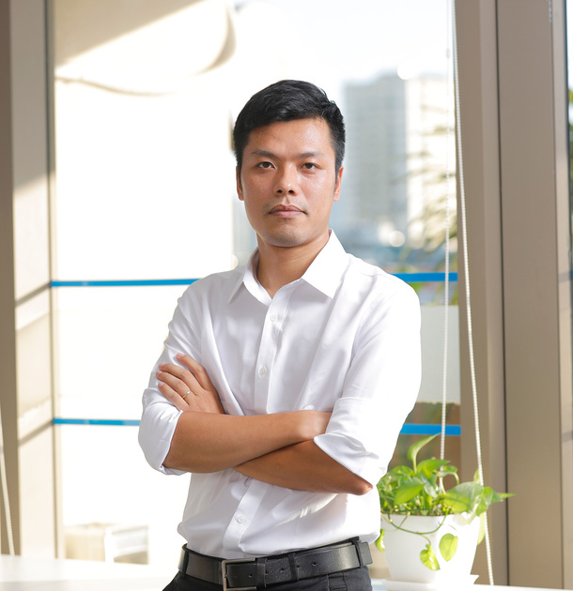
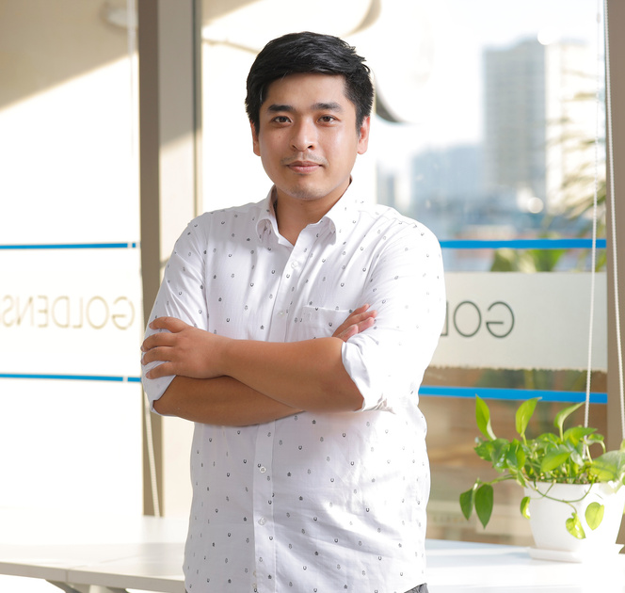
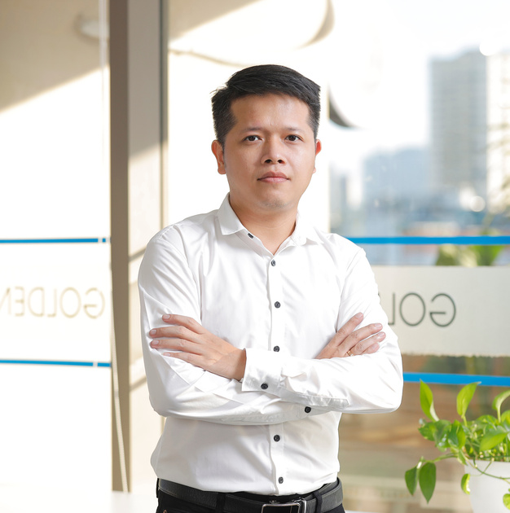
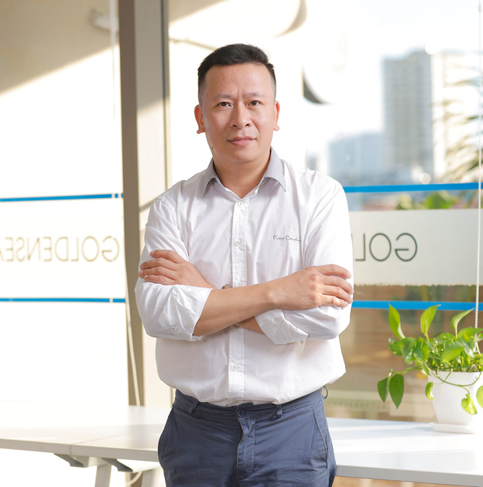
LEADERSHIP TEAM
100% of Goldensea's personnel have over 10 years of experience
Alice Quynh
Nguyen Nhu Nghiem
Nguyen Quoc Khanh
Le Huu Thinh
Lai Quang Hiep
Ceo
Operational
Planning
Design Concept
Site Supervisor
20 years of experience in the office interior sector. Led over 1,500 office interior projects of various scales across many provinces and cities nationwide.
Over 14 years of experience in office interior design and fit-out projects for Grade A and B buildings in Hanoi.
Graduated with a qualification in project management from the Russian Federation and possesses over 12 years of experience in the office furniture industry.
Architect (Master’s degree holder) with over 14 years of experience in office interior design and construction projects for Grade A and B buildings in Hanoi.
Over 20 years of experience in office interior design and construction projects for Grade A and B buildings in Hanoi; 100% of projects completed on schedule.

Slide 10
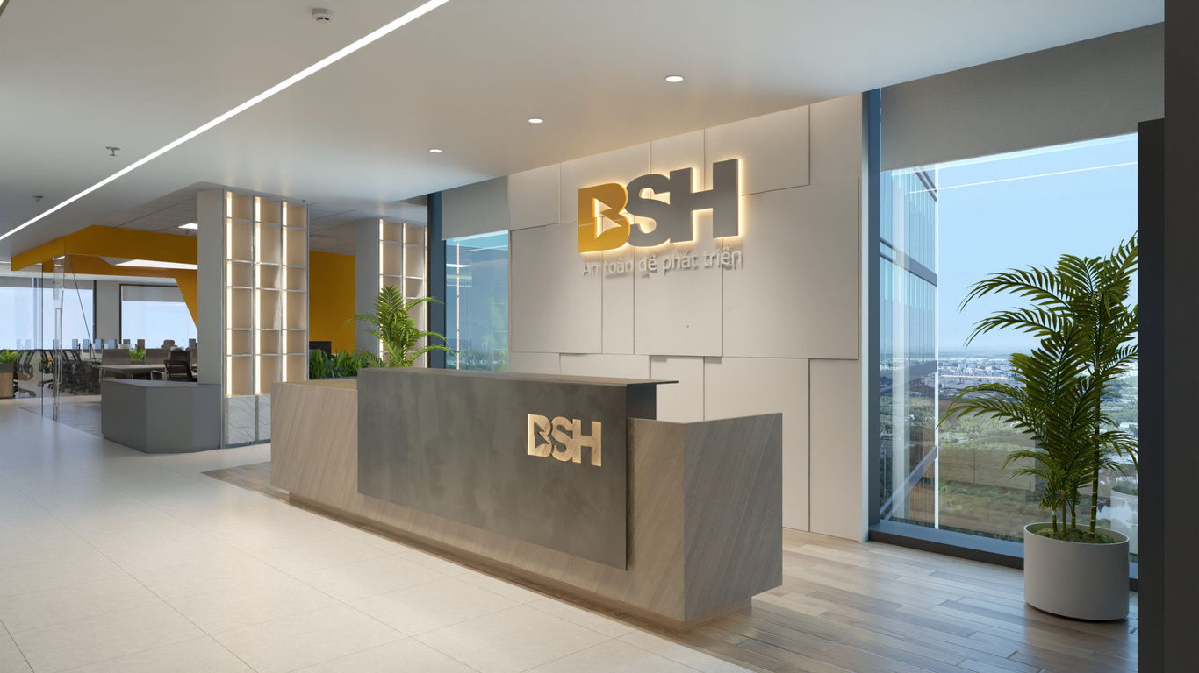
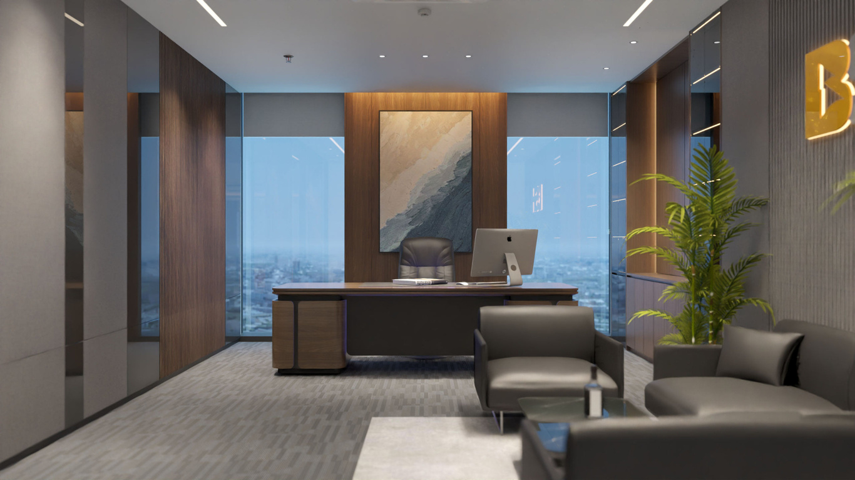
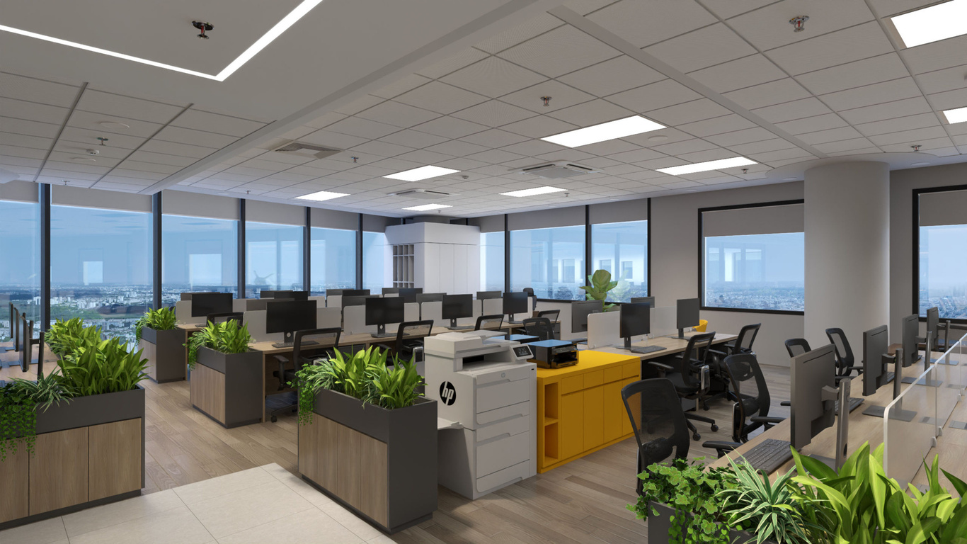
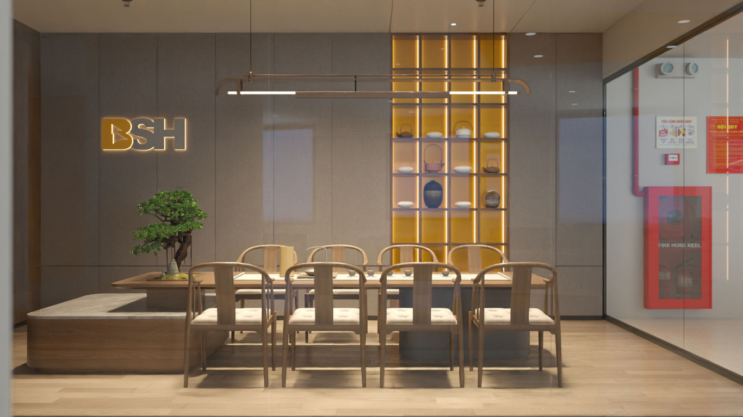
BSH OFFICE
23rd Floor – Vinacomin Building, Duong Dinh Nghe, Hanoi
60
1700
DAYS
M2
Turnkey office interior design and construction

Slide 11
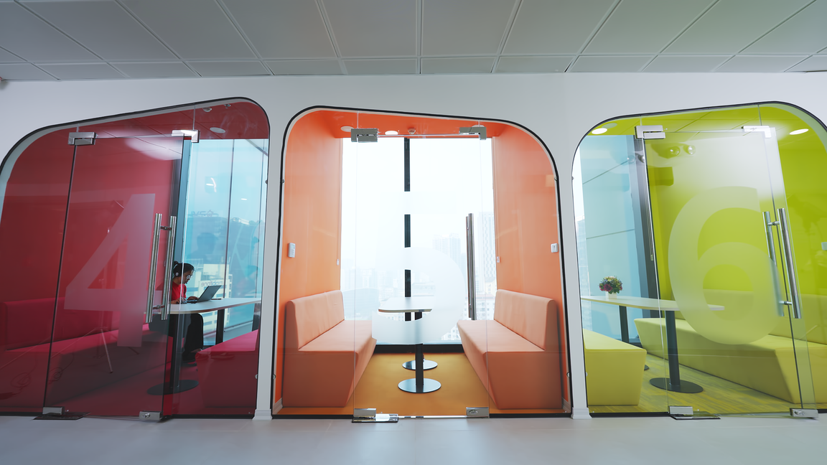
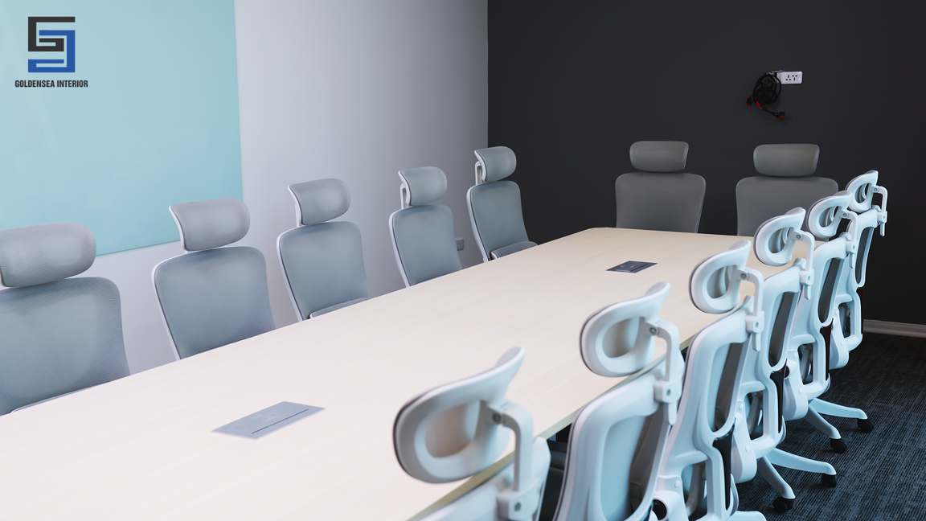
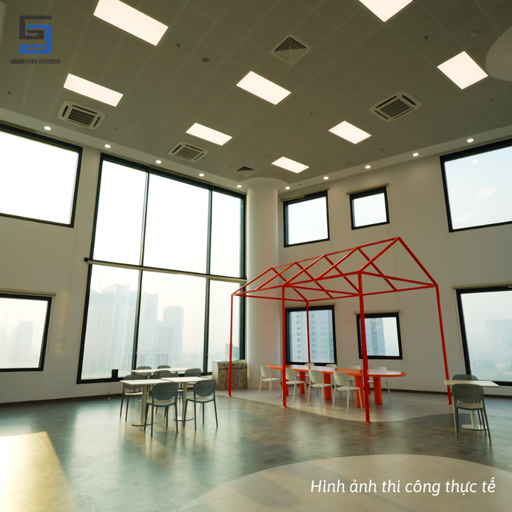
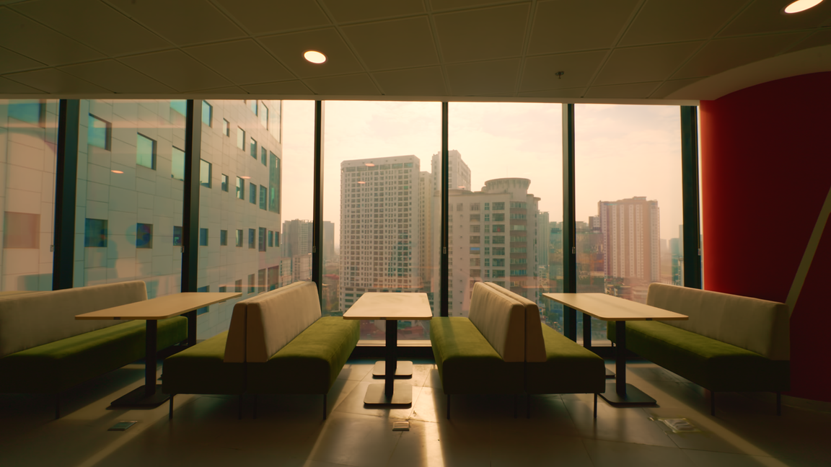
REIKKEI SOLF
13th – 14th Floor, Vinacomin Tower, Duong Dinh Nghe, Hanoi
55
3400
DAYS
M2
Consulting and Construction work

Slide 12
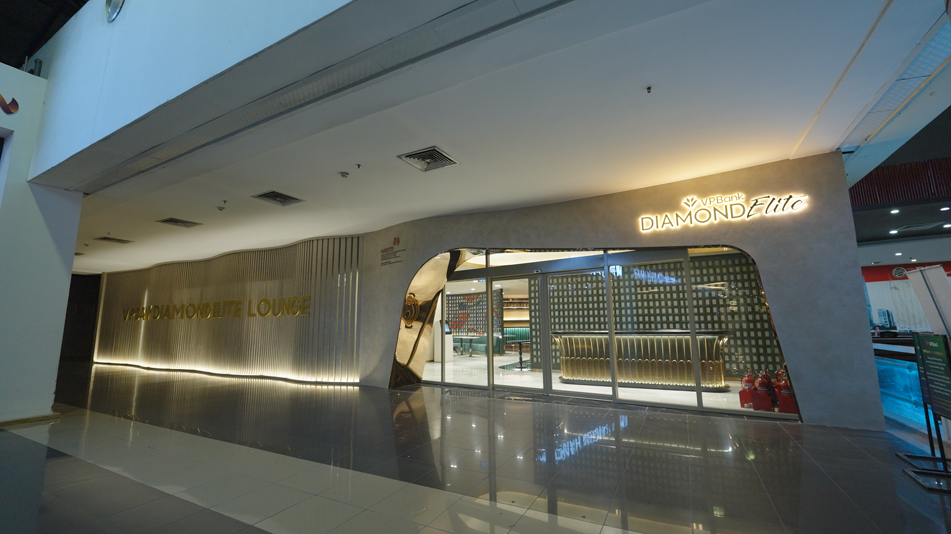
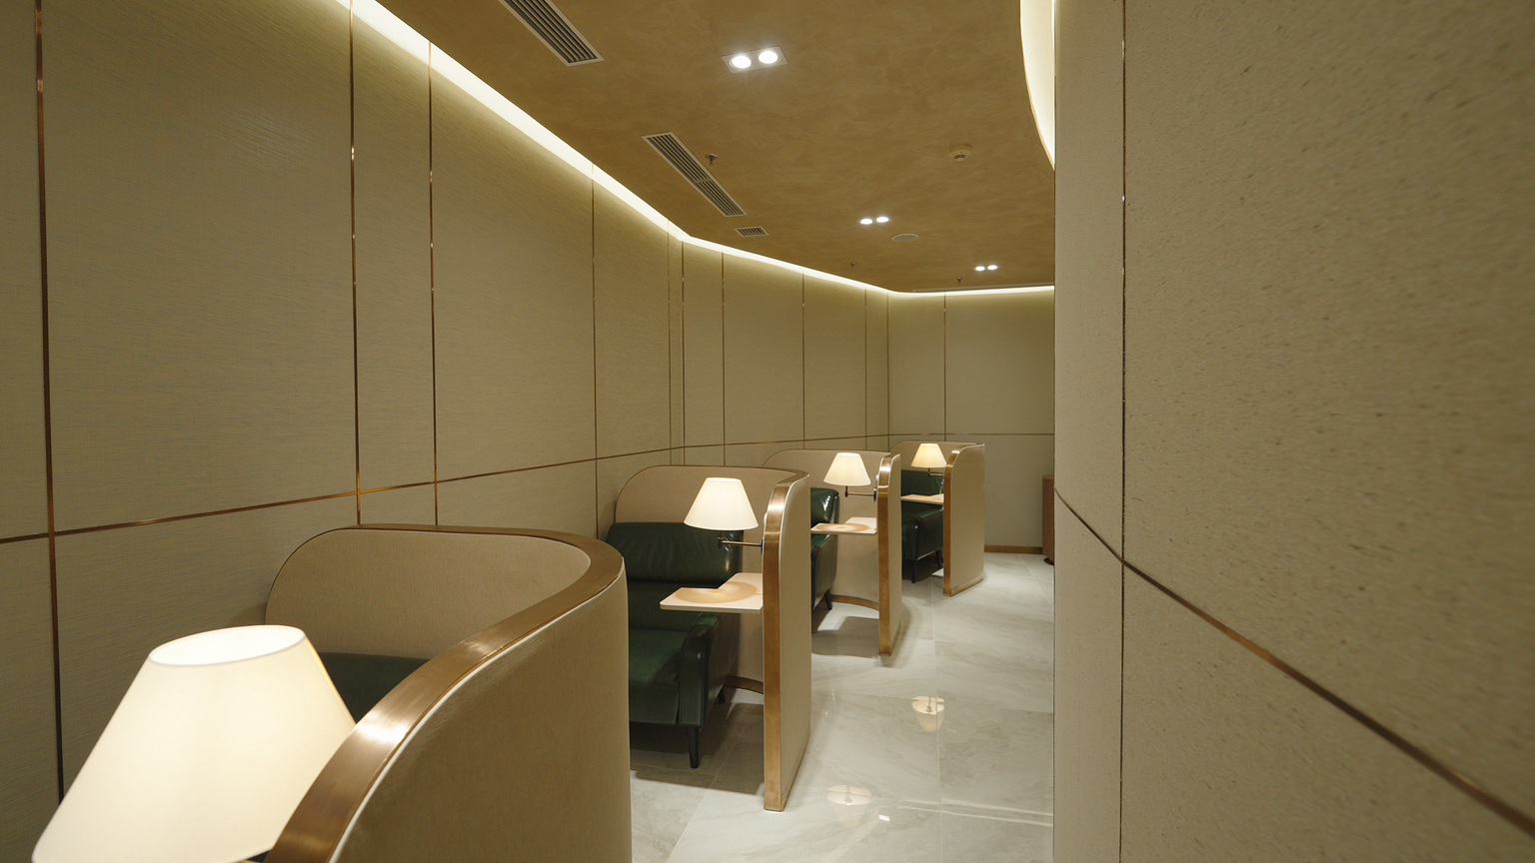
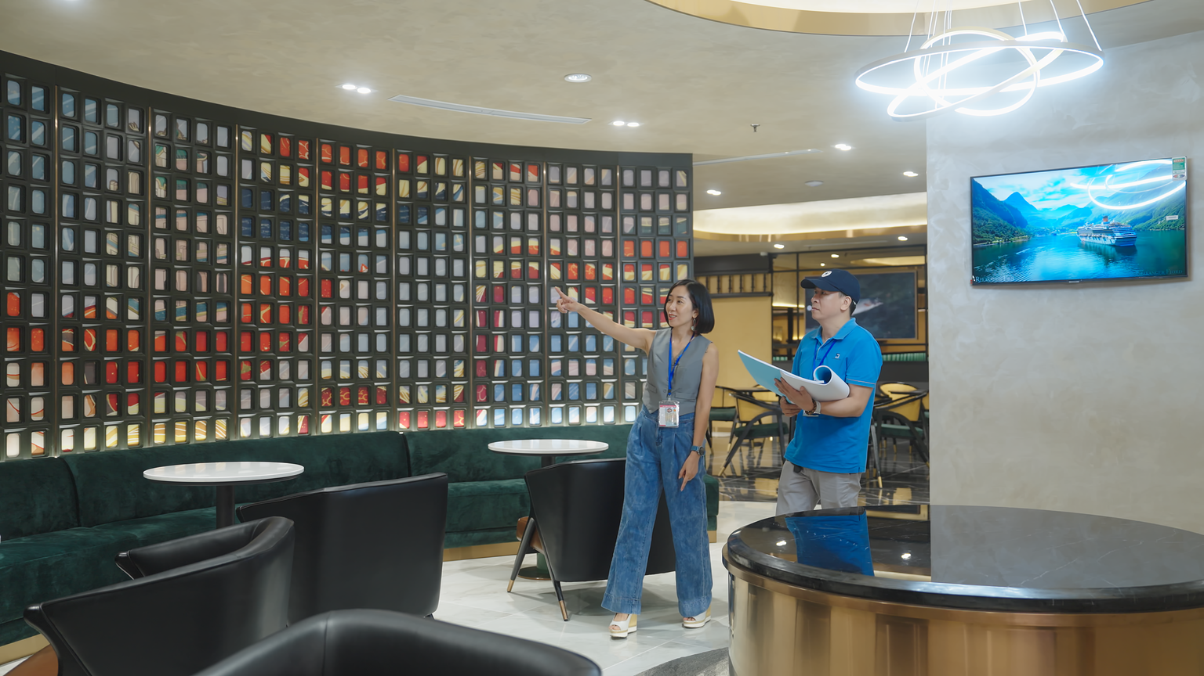
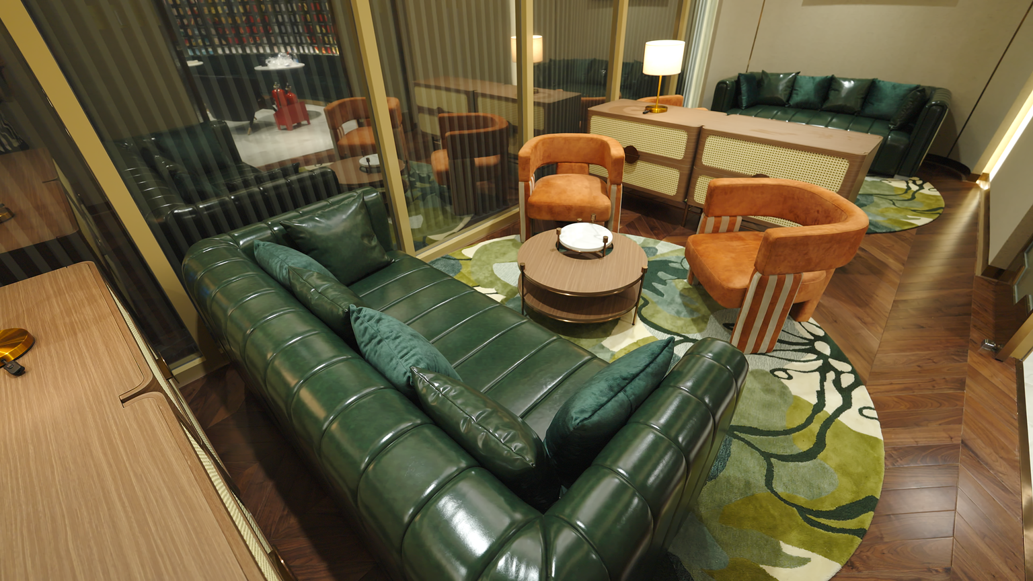
VPbank louge
3rd Floor - Nọi Bai International Airport, Hanoi
90
350
DAYS
M2
Consulting and Construction work

Slide 13
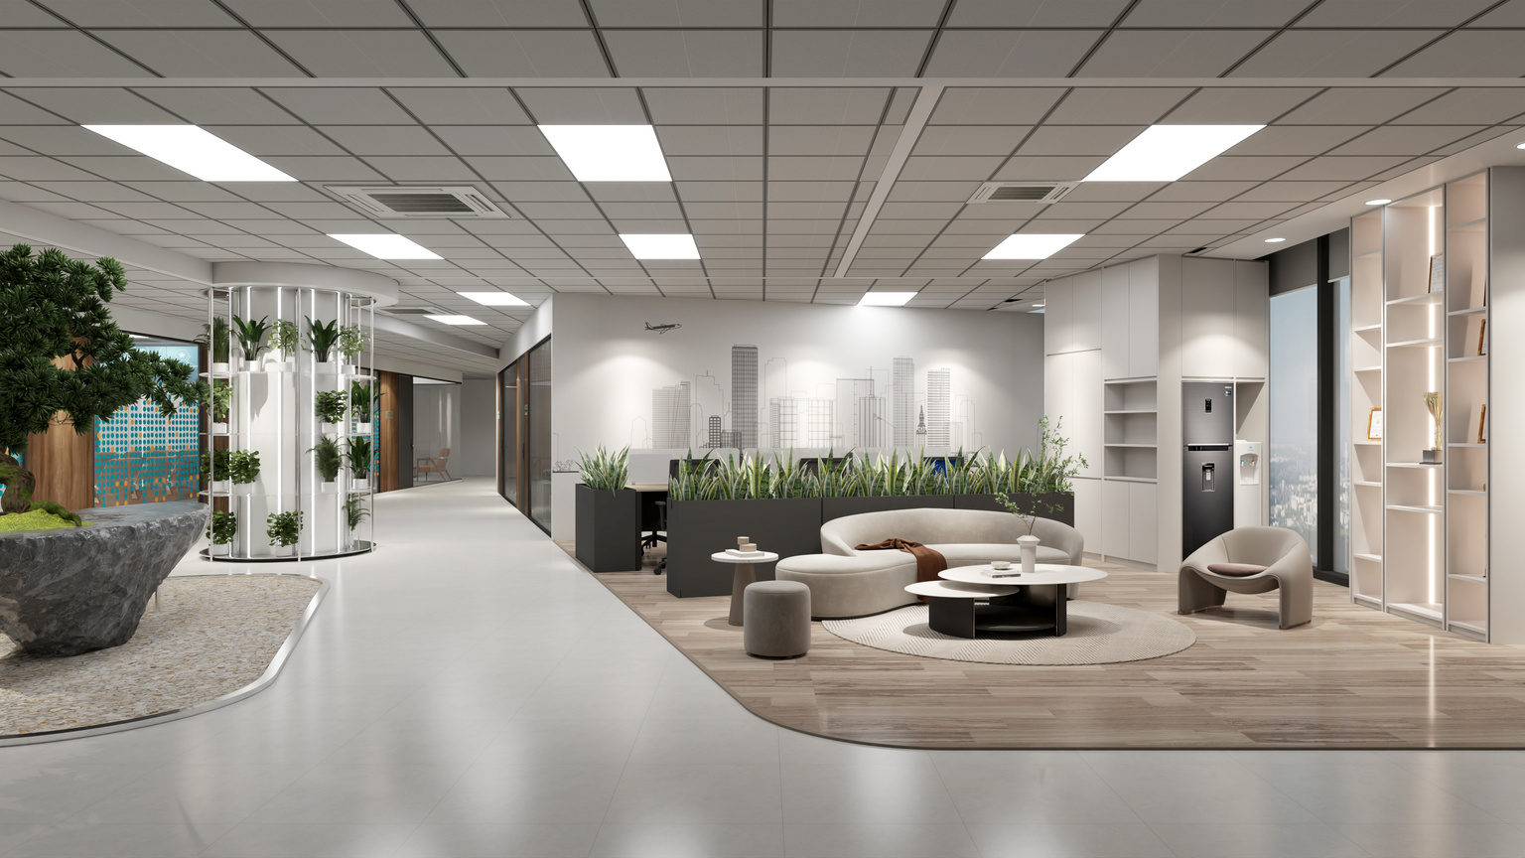
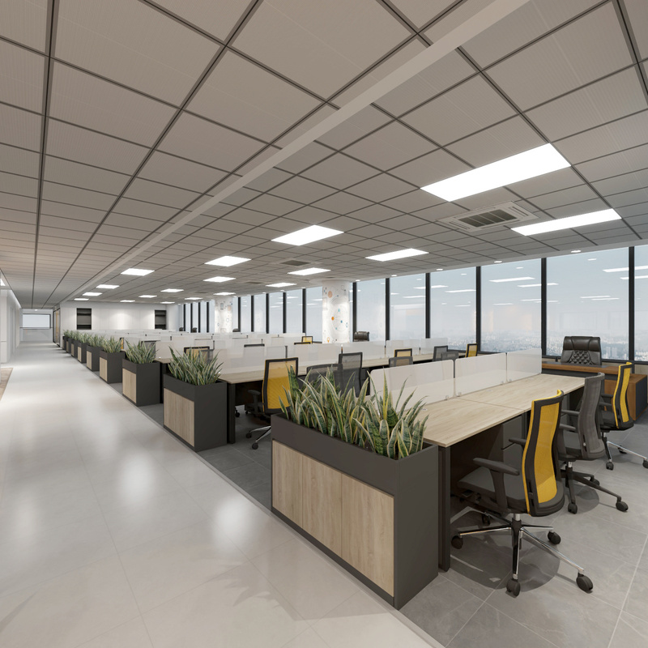
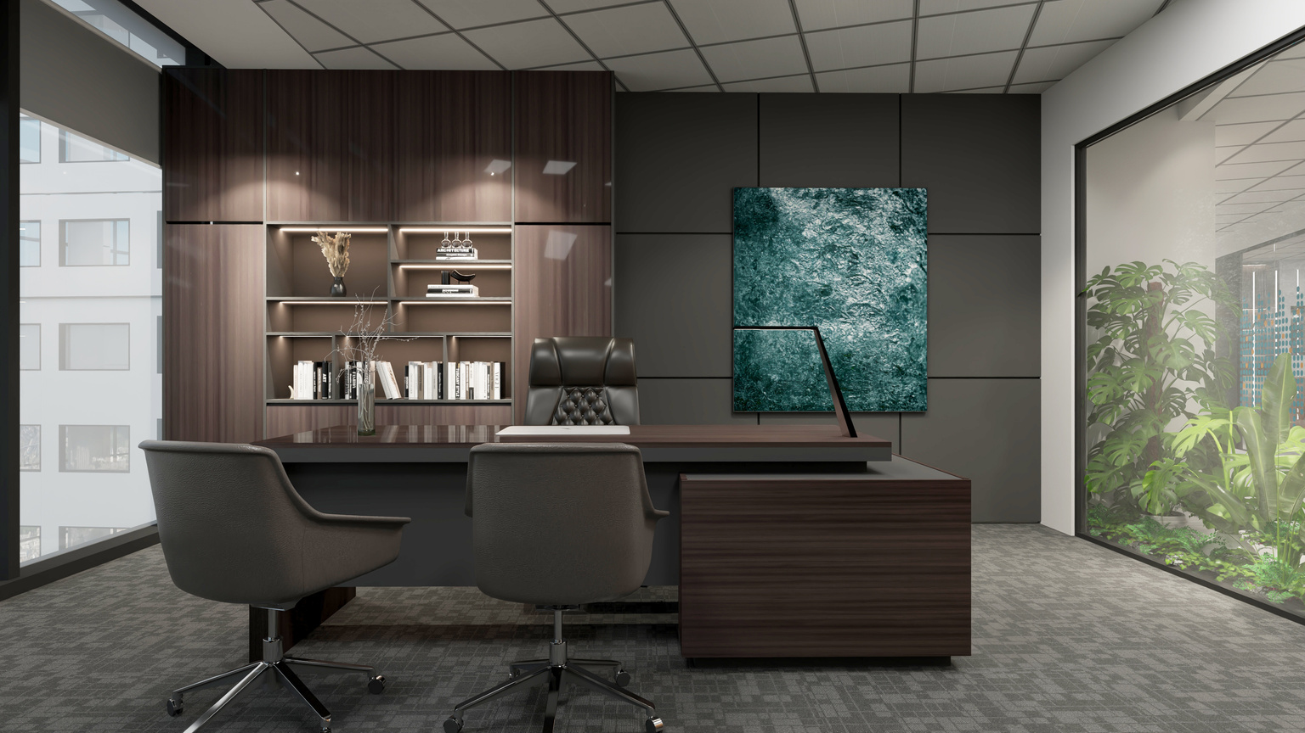
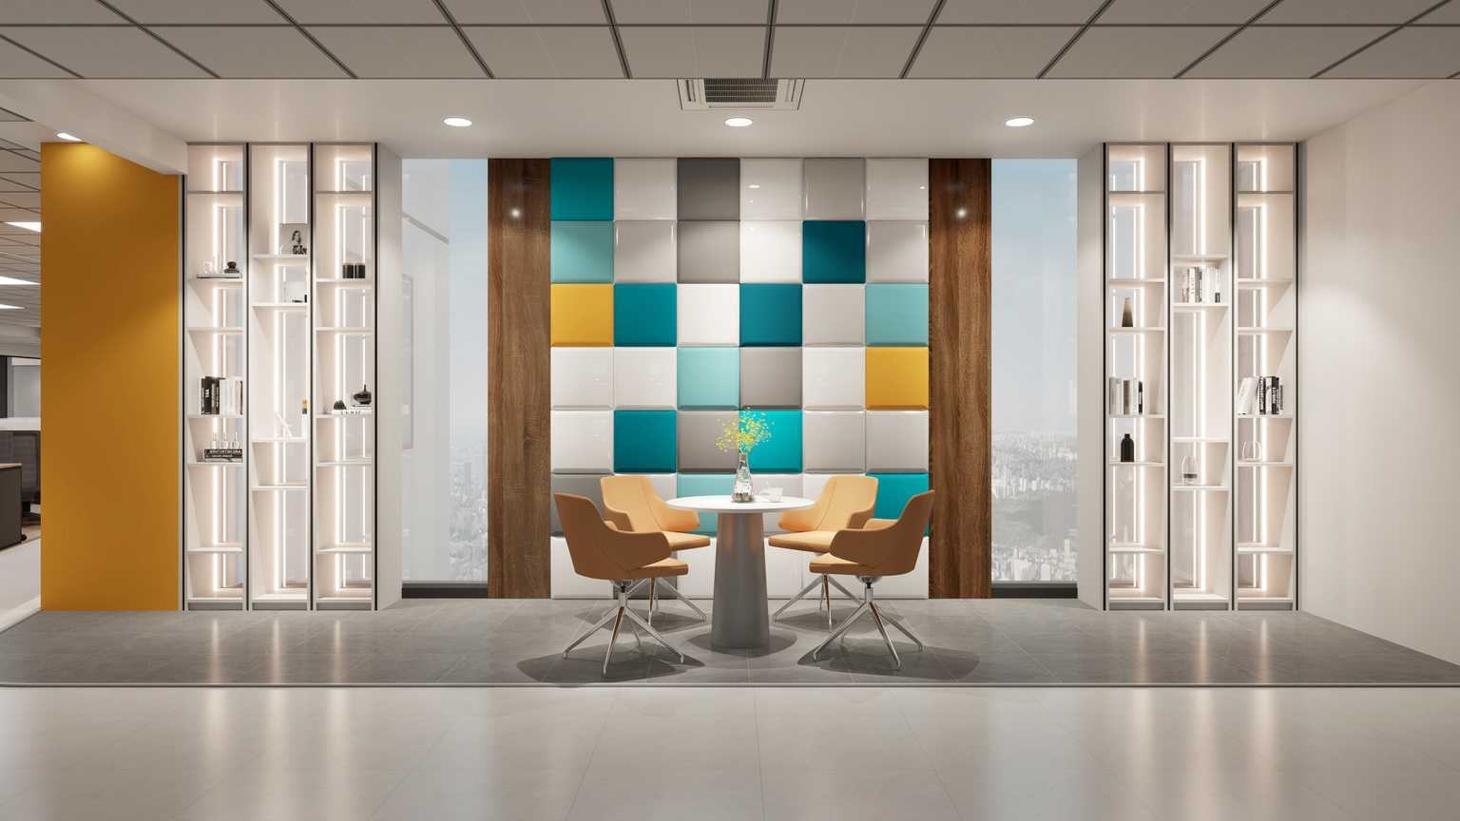
VNI OFFICE
24th Floor – Vinacomin Building, Duong Dinh Nghe, Hanoi
60
1700
DAYS
M2
Turnkey office interior design and construction

Slide 14
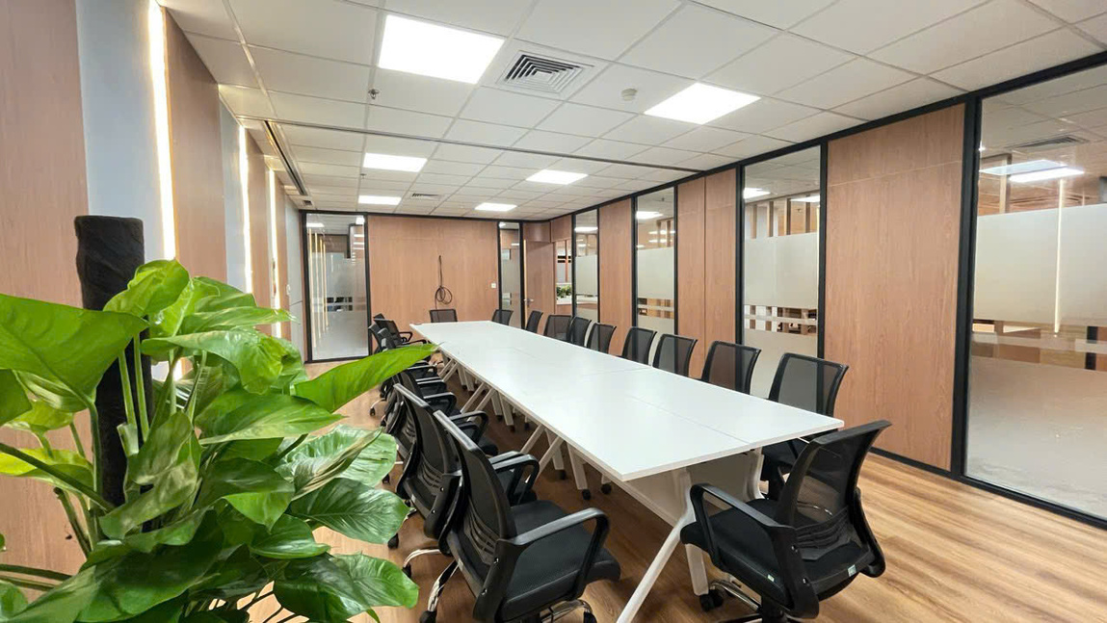
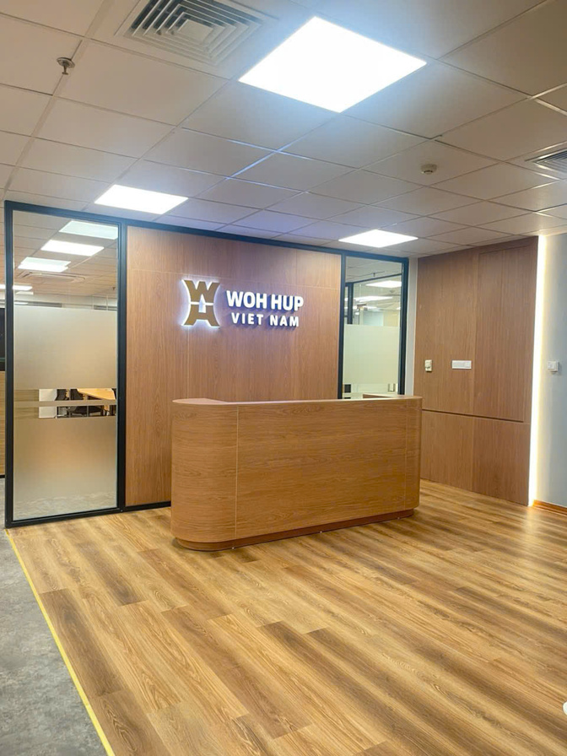
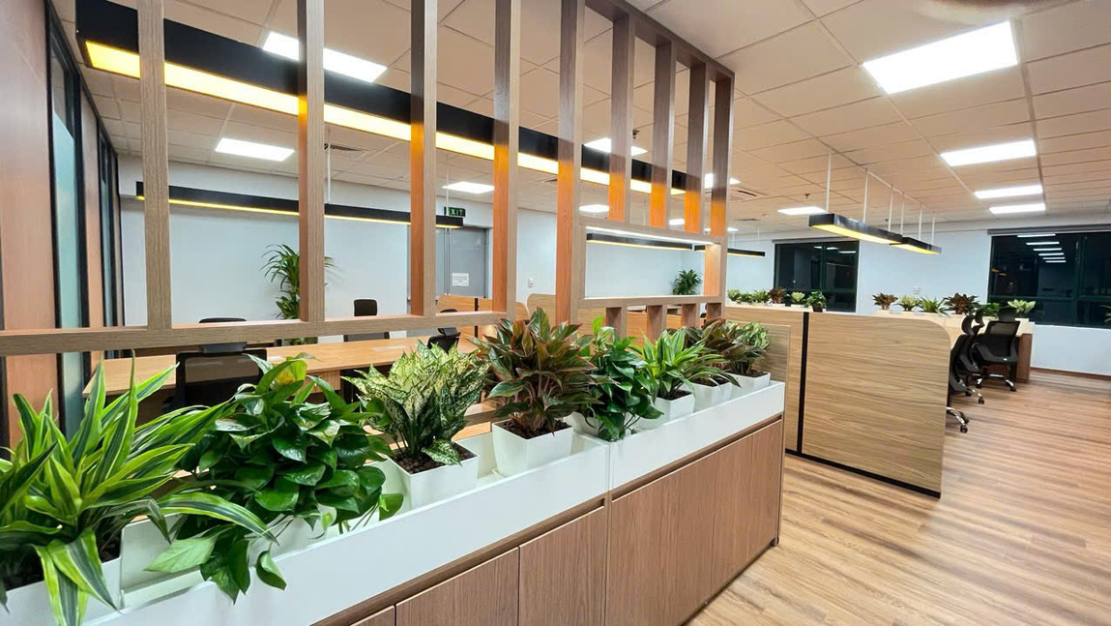
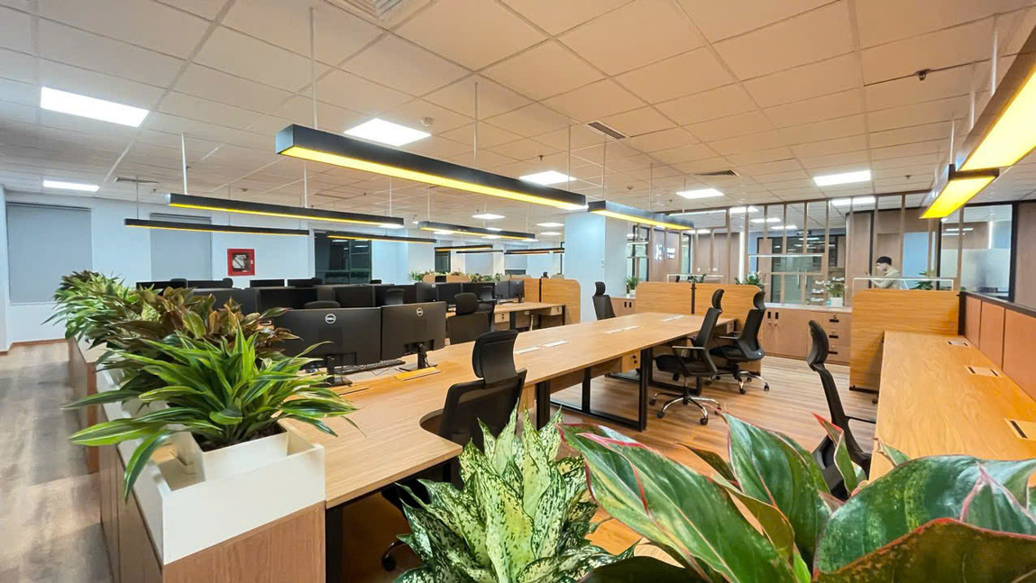
WOHUP OFFICE
3rd And 8th Floor - 4 Lang Ha Building, Hanoi
30
450
DAYS
M2
Turnkey office interior design and construction

Slide 15
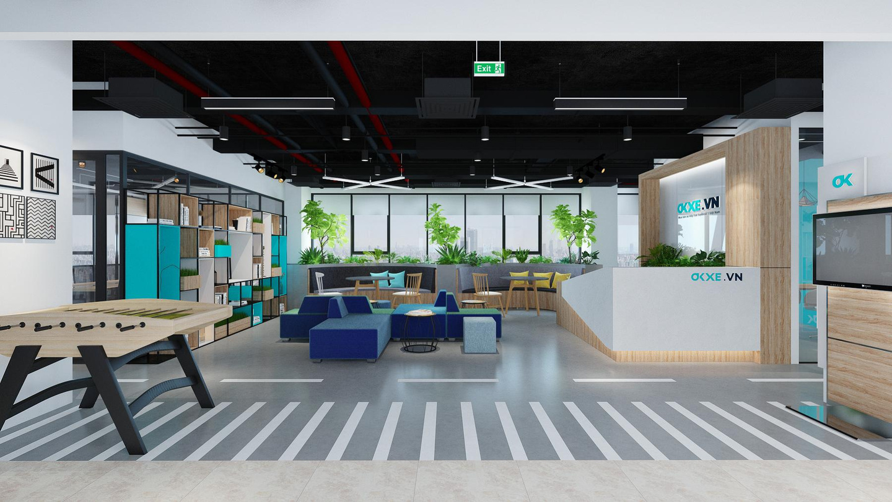
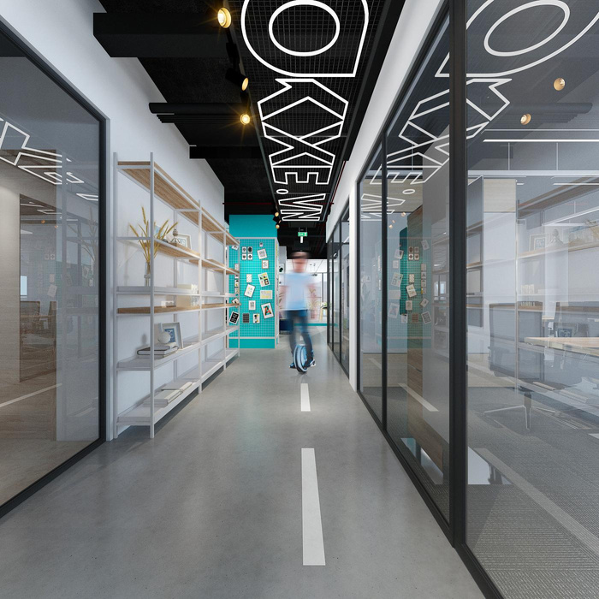
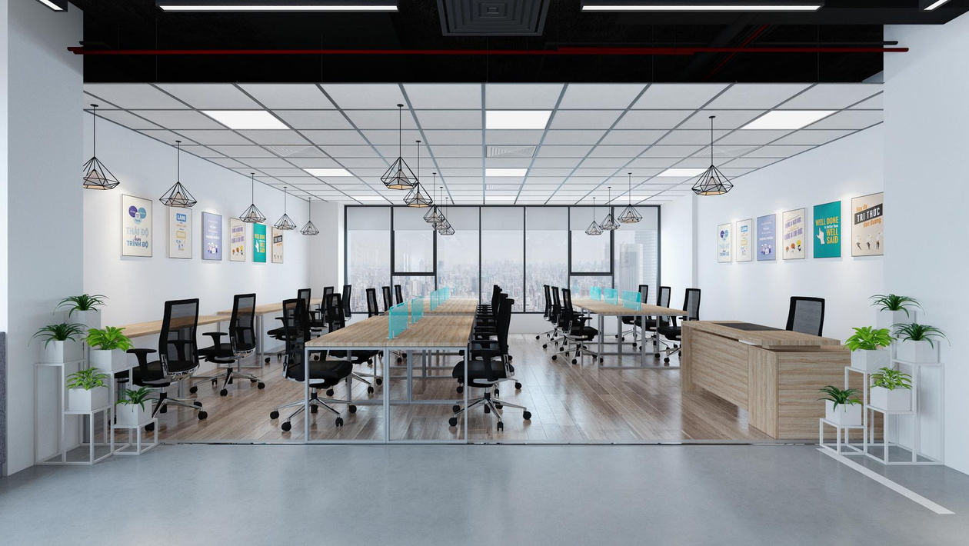
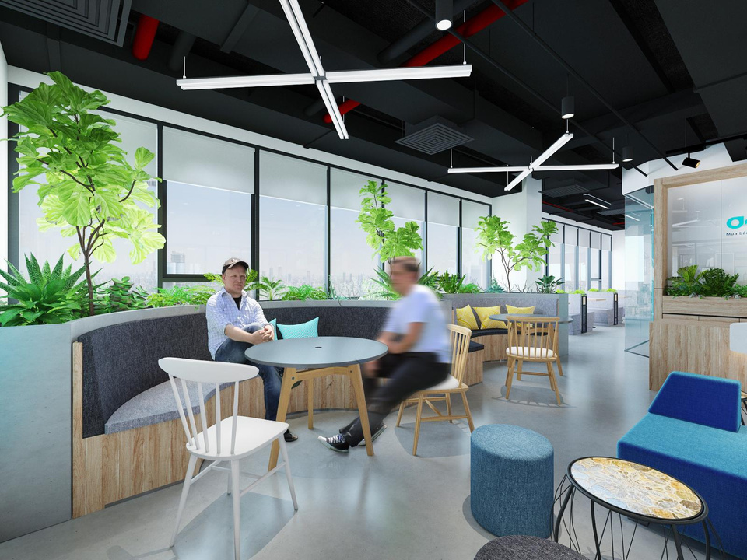
OKXE
9th Sao Mai Building – Le Van Luong, Hanoi
30
400
DAYS
M2
Turnkey office interior design and construction

Slide 16


GOLDENSEA INTERIOR
094 558 6611
Email
website
Address
info@goldensea.net.vn
Goldensea.net.vn
V1 Homecity, 177 Trung Kinh, Yen Hoa, Hanoi / Bui Viet Chanh, Binh Thach, Hochiminh City

